Slide 1


Flying dreams
CONTRIBUTION
GET STARTED
EXIT

Slide 2


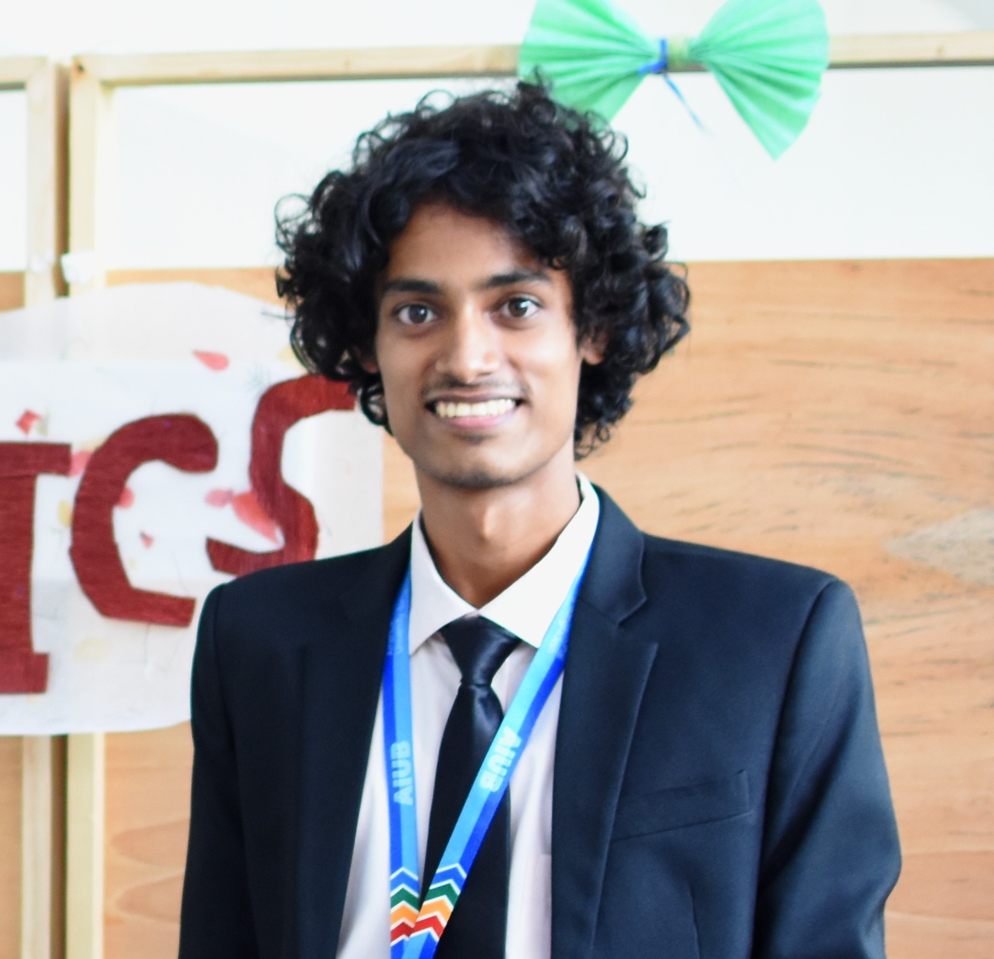

Md. Al Amin
22-48081-2
Md. Nooruzzaman
22-48082-2
okay

Slide 3

Log In
Hello! Let’s get started
Admin Log In
User Log In
User Name
Password
SUBMIT
Don’t you have an account? Sign Up

Slide 4
Create Account
Enter Your Information
User Name
Mail
Password
Security Question
Your Answer
Captcha 10+2
SUBMIT
Already have an account? Log In

Slide 5






Welcome to Flying Dreams
Let’s fly with dreams..
Flying dreams
Global Study Specialists
Education || Migration
Explore Countries
Find a Course
University
Next

Slide 6
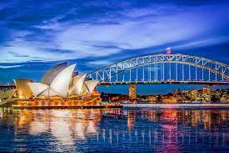
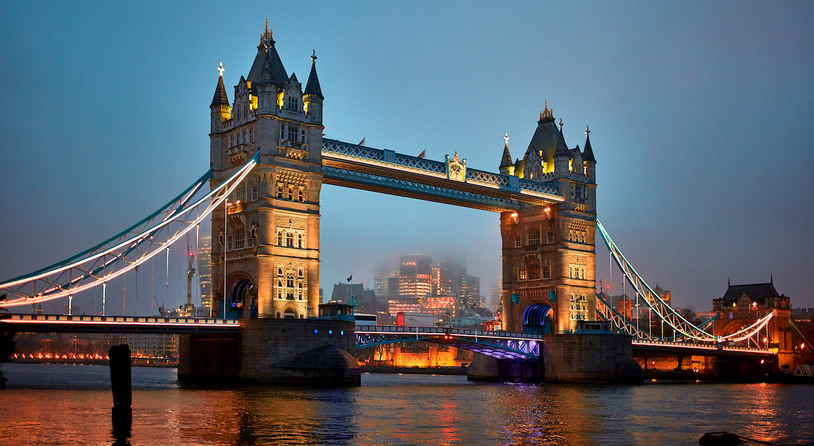


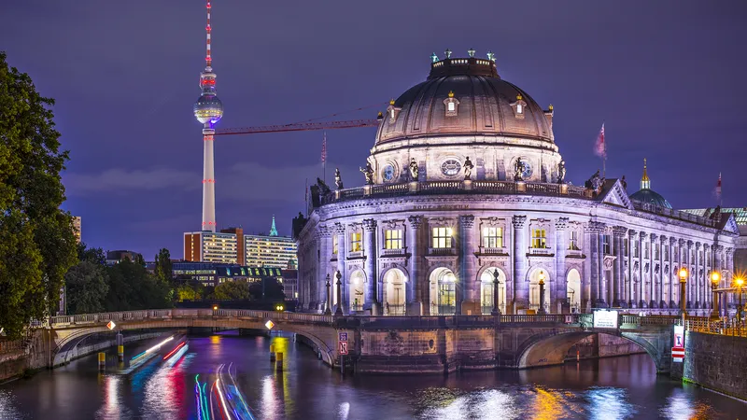


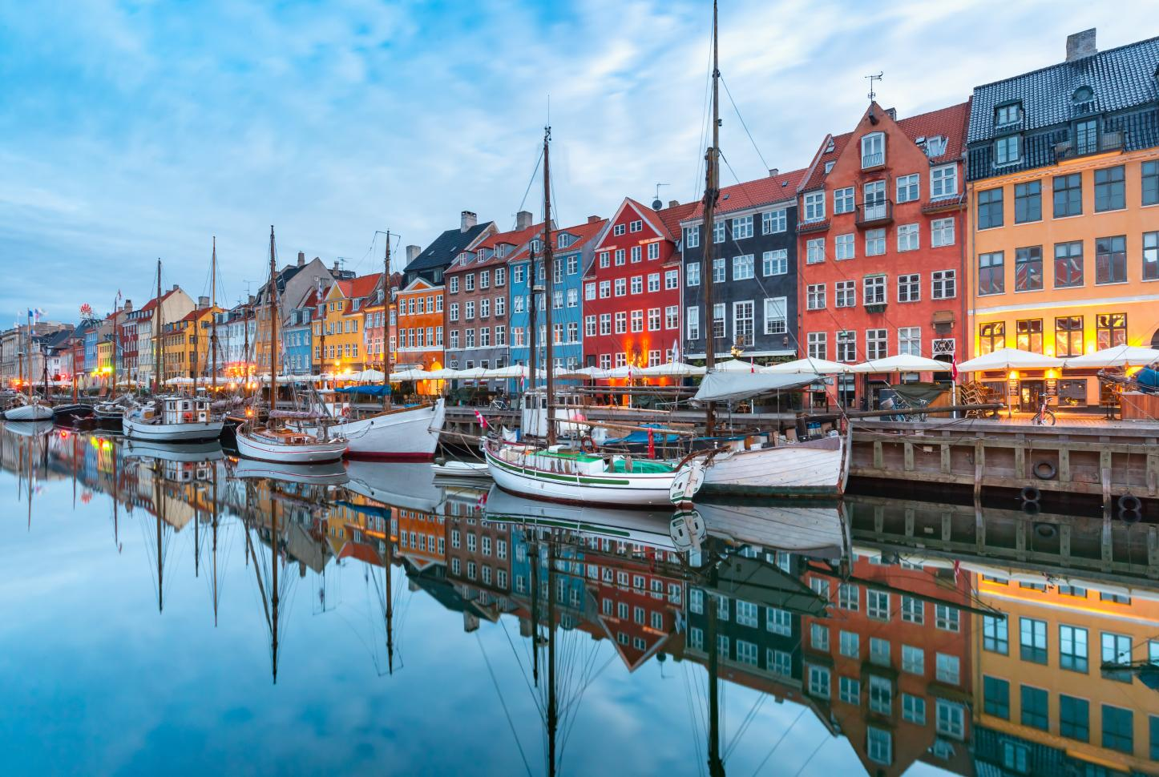
Welcome to Flying Dreams
Let’s fly with dreams..
Next
Australia
UK
USA
Malaysia
Germany
Finland
Canada
Denmark

Slide 7





Welcome to Flying Dreams
Let’s fly with dreams..
Next
Australia
Swinburne University
University of Sydney
University of Melbourne
Monash University

Slide 8
Welcome to Flying Dreams
Let’s fly with dreams..
Swinburne University of Technology
Apply Now
Why Swinburne?
About Swinburne
Tuition Fees
Courses

Slide 9
Welcome to Flying Dreams
Let’s fly with dreams..
Swinburne University of Technology
Top six reasons why you should choose Swinburne
1. We are an internationally recognized university.
2. Our industry connections and workplace experience.
3. High-quality research and teaching.
4. Cutting-edge facilities that enhance learning.
5. We offer flexible study options.
6. You can access the Swinburne Advantage.
Next

Slide 10
Welcome to Flying Dreams
Let’s fly with dreams..
Swinburne University of Technology
About
Swinburne is a world-ranked university leading the way in innovation, industry engagement and social inclusion. Our education, high-quality research and industry partnerships create positive change for students, staff and the community.
Next

Slide 11
Welcome to Flying Dreams
Let’s fly with dreams..
Swinburne University of Technology
Study area | Course type | Indicative course fee*
Arts and social sciences | Bachelor degree | A$31,000 annual
Law | Bachelor degree | A$32,160 annual
Business and management | Bachelor degree | A$36,900 annual
Design | Bachelor degree | A$35,640–A$37,200 annual
Health sciences and community care | Bachelor degree | A$37,700–A$39,960 annual
Engineering | Bachelor degree | A$40,600 annual
Film and television | Bachelor degree | A$38,960 annual
Next

Slide 12
Welcome to Flying Dreams
Let’s fly with dreams..
Swinburne University of Technology
Study area | Course type
Arts and social sciences | Bachelor degree
Law | Bachelor degree
Business and management | Bachelor degree
Design | Bachelor degree
Health sciences and community care | Bachelor degree
Engineering | Bachelor degree
Film and television | Bachelor degree
Study area | Course type
Science | Bachelor degree
Aviation | Bachelor degree
Media and communications | Bachelor degree
Games & interactivity | Bachelor degree
Information Technologies | Bachelor degree
Psychology | Bachelor degree
Education | Bachelor degree
Next

Slide 13
Welcome to Flying Dreams
Let’s fly with dreams..
Swinburne University of Technology
Welcome to Swinburne University of Technology's International Online Application System
Our online application system allows you to:
Apply for Swinburne courses
Save and edit incomplete applications before submitted
View status updates on the progress of your application(s)
Save and print your completed applications and supporting documents
Register
Log In

Slide 14
Welcome to Flying Dreams
Let’s fly with dreams..
University of Sydney
Why SU?
About University
Tuition Fees
Courses

Slide 15
Welcome to Flying Dreams
Let’s fly with dreams..
University of Sydney
Top six reasons why you should choose University of Sydney
1. A top research university.
2. Degrees designed for you.
3. The world's third most livable city.
4. 200+ clubs and societies.
5. Australia's largest study abroad and exchange program.
6. A wide range of scholarships.
Back
Next

Slide 16
Welcome to Flying Dreams
Let’s fly with dreams..
University of Sydney
About
The University of Sydney was founded in 1850 as a public institution of higher education.
The University has a vast history covering many aspects of intellectual, scientific and socio-political life in Australia. Below are pathways to explore our history.
University of Sydney is a world-ranked university leading the way in innovation, industry engagement and social inclusion. Our education, high-quality research and industry partnerships create positive change for students, staff and the community.
Back
Next

Slide 17
Welcome to Flying Dreams
Let’s fly with dreams..
University of Sydney
Study area | Course type | Indicative course fee*
Faculty of Arts and social sciences | Bachelor degree | A$27,000 annual
School of Law | Bachelor degree | A$30,160 annual
Faculty of Business Administration | Bachelor degree | A$32,000 annual
Faculty of Medicine and Healthcare | Bachelor degree | A$40,640–A$42,200 annual
Faculty of Science and Technology | Bachelor degree | A$39,700–A$41,960 annual
Faculty of Engineering | Bachelor degree | A$40,600 annual
Media and Television | Bachelor degree | A$28,960 annual
Back
Next

Slide 18
Welcome to Flying Dreams
Let’s fly with dreams..
University of Melbourne
Why MU?
About University
Tuition Fees
Courses

Slide 19
Welcome to Flying Dreams
Let’s fly with dreams..
Monash University
Why Monash?
About University
Tuition Fees
Courses

Slide 20




Welcome to Flying Dreams
Let’s fly with dreams..
Back
United Kingdom
University of Oxford
University of Cambridge
University of Manchester
University of Bristol

Slide 21





Welcome to Flying Dreams
Let’s fly with dreams..
Back
U.S.A
University of Chicago
Harvard University
Stanford University
Princeton University

Slide 22



Welcome to Flying Dreams
Let’s fly with dreams..
Back
Malaysia
University Malaya
University Putra
Monash University

Slide 23



Welcome to Flying Dreams
Let’s fly with dreams..
Back
Finland
Tampere University
University of Oulu
University of Turku

Slide 24




Welcome to Flying Dreams
Let’s fly with dreams..
Back
Germany
Berlin Institute of Technology
University of Freiburg
RWTH Aachen University
Heidelberg University

Slide 25




Welcome to Flying Dreams
Let’s fly with dreams..
Back
Canada
Queen’s University
University of Toronto
University of Waterloo
University of Manitoba

Slide 26



Welcome to Flying Dreams
Let’s fly with dreams..
Back
Denmark
University of Copenhagen
Aarhus University
Aalborg University

Slide 27








Welcome to Flying Dreams
Let’s fly with dreams..
Back
Engineering
Health & Medicine
Arts & Design
Business
History
Social Science
Agriculture
Law

Slide 28





Welcome to Flying Dreams
Let’s fly with dreams..
Back
Civil Engineering
Mechanical Engineering
Electrical Engineering
Biomedical Engineering
Architecture
Computer Engineering

Slide 29




Welcome to Flying Dreams
Let’s fly with dreams..
Civil Engineering
Swinburne University
University of Sydney
University of Melbourne
Monash University
BIT
University of Freiburg
University of Chicago
University of Harvard
Stanford University
Princeton University
RWTH University
Heidelberg University
Queen’s University
University of Toronto
University of Waterloo
University of Manitoba
Aalborg University
Roskilde University
Tampere University
University of Oulu
University of Turku
Aalto University
Back

Slide 30
Welcome to Flying Dreams
Let’s fly with dreams..
Mechanical Engineering
Swinburne University
University of Sydney
University of Melbourne
Monash University
University of Chicago
University of Harvard
Stanford University
Princeton University
BIT
University of Freiburg
Queen’s University
University of Toronto
University of Waterloo
University of Manitoba
RWTH University
Heidelberg University
Tampere University
University of Oulu
University of Turku
Aalto University
Back

Slide 31


Welcome to Flying Dreams
Let’s fly with dreams..
Electrical Engineering
Tampere University
University of Oulu
University of Turku
Aalto University
University of Chicago
University of Harvard
Stanford University
Princeton University
BIT
University of Freiburg
Queen’s University
University of Toronto
University of Waterloo
University of Manitoba
RWTH University
Heidelberg University
Monash University
Utara University
Roskilde University
Aalborg University
Back

Slide 32
Welcome to Flying Dreams
Let’s fly with dreams..
Biomedical Engineering
Tampere University
University of Oulu
University of Turku
Aalto University
University of Chicago
University of Harvard
Stanford University
Princeton University
Queen’s University
University of Toronto
University of Waterloo
University of Manitoba
Monash University
Utara University
Roskilde University
Aalborg University

Slide 33
Welcome to Flying Dreams
Let’s fly with dreams..
Architecture
Swinburne University
University of Sydney
University of Melbourne
Monash University
BIT
University of Freiburg
University of Chicago
University of Harvard
Stanford University
Princeton University
RWTH University
Heidelberg University
Queen’s University
University of Toronto
University of Waterloo
University of Manitoba
Aalborg University
Roskilde University
Tampere University
University of Oulu
University of Turku
Aalto University
Back

Slide 34
Welcome to Flying Dreams
Let’s fly with dreams..
Computer Engineering
Swinburne University
University of Sydney
University of Melbourne
Monash University
University of Oxford
BIT
University of Freiburg
University of Chicago
University of Harvard
Stanford University
Princeton University
University of Manchester
RWTH University
Heidelberg University
Queen’s University
University of Toronto
University of Waterloo
University of Manitoba
Malaya University
Aalborg University
Roskilde University
Tampere University
University of Oulu
University of Turku
Aalto University
Putra University
Back

Slide 35
Welcome to Flying Dreams
Let’s fly with dreams..
Health & Medicine
University of Chicago
University of Manitoba
University of Harvard
Stanford University
Queen’s University
University of Toronto
University of Waterloo
Princeton University
Back

Slide 36
Welcome to Flying Dreams
Let’s fly with dreams..
Arts & Design
Swinburne University
University of Sydney
University of Melbourne
Monash University
University of Chicago
University of Harvard
Stanford University
Princeton University
Aalborg University
Roskilde University
Queen’s University
University of Toronto
University of Waterloo
University of Manitoba
Utara University
University of Cambridge
University of Bristol
University of Oxford
University of Manchester
Back

Slide 37
Welcome to Flying Dreams
Let’s fly with dreams..
Business
Swinburne University
University of Sydney
University of Melbourne
Monash University
Aalborg University
Roskilde University
University of Chicago
University of Harvard
Stanford University
Princeton University
Utara University
Malaya University
Queen’s University
University of Toronto
University of Waterloo
University of Manitoba
RWTH University
Heidelberg University
University of Cambridge
University of Bristol
University of Oxford
University of Manchester
Back

Slide 38
Welcome to Flying Dreams
Let’s fly with dreams..
Social Science
Swinburne University
University of Sydney
University of Melbourne
Monash University
University of Chicago
University of Harvard
Stanford University
Princeton University
Aalborg University
Roskilde University
Queen’s University
University of Toronto
University of Waterloo
University of Manitoba
Utara University
Malaya University
University of Cambridge
University of Bristol
University of Oxford
University of Manchester
Back

Slide 39
Welcome to Flying Dreams
Let’s fly with dreams..
History
RWTH University
Heidelberg University
University of Melbourne
Monash University
University of Chicago
University of Harvard
Stanford University
Princeton University
Aalborg University
Roskilde University
Queen’s University
University of Toronto
University of Waterloo
University of Manitoba
Utara University
Malaya University
University of Cambridge
University of Bristol
University of Oxford
University of Manchester
Back

Slide 40

Welcome to Flying Dreams
Let’s fly with dreams..
Agriculture
University of Chicago
Princeton University
Utara University
Roskilde University
Aarhus University
University of Copenhagen
Aalborg University
Back

Slide 41
Welcome to Flying Dreams
Let’s fly with dreams..
Law
Swinburne University
University of Sydney
University of Melbourne
Monash University
Aalborg University
Roskilde University
University of Chicago
University of Harvard
Stanford University
Princeton University
Utara University
Malaya University
Queen’s University
University of Toronto
University of Waterloo
University of Manitoba
RWTH University
Heidelberg University
University of Cambridge
University of Bristol
University of Oxford
University of Manchester
Back

Slide 42
Welcome to Flying Dreams
Let’s fly with dreams..
University | Country
Heidelberg University | Germany
Queen’s University | Canada
University of Toronto | Canada
University of Waterloo | Canada
University of Manitoba | Canada
University of Copenhagen | Denmark
Aarhus University | Denmark
Area | Scholarship
Heidelberg | No
Kingston | Yes
Toronto | Yes
Southern Ontario | Yes
Winnipeg | Yes
Copenhagen | Yes
Aarhus | No
Aalborg University | Denmark
Tampere University | Finland
University of Oulu | Finland
University of Turku | Finland
Malaya University | Malaysia
Monash University | Malaysia
Putra University | Malaysia
Aalborg | No
Tampere | Yes
Oulu | Yes
Southwestern | Yes
Malaya | Yes
Bandar Sunway | Yes
Selangor | Yes

Slide 43
Welcome to Flying Dreams
Let’s fly with dreams..
University | Country
Swinburne University | Australia
University of Sydney | Australia
University of Melbourne | Australia
University of Cambridge | UK
University of Oxford | UK
University of Manchester | UK
University of Bristol | UK
Area | Scholarship
Melbourne | Yes
Sydney | Yes
Melbourne | Yes
Cambridge | No
Oxford | No
Manchester | Yes
Bristol | Yes
University of Chicago | USA
University of Harvard | USA
Stanford University | USA
University of Princeton | USA
Berlin Institute of Tech: | Germany
University of Freiburg | Germany
RWTH University | Germany
Chicago | Yes
Massachusetts | No
California | No
New Jersey | Yes
Berlin | No
Freiburg | No
Aachen | No
Back

